Slide 1
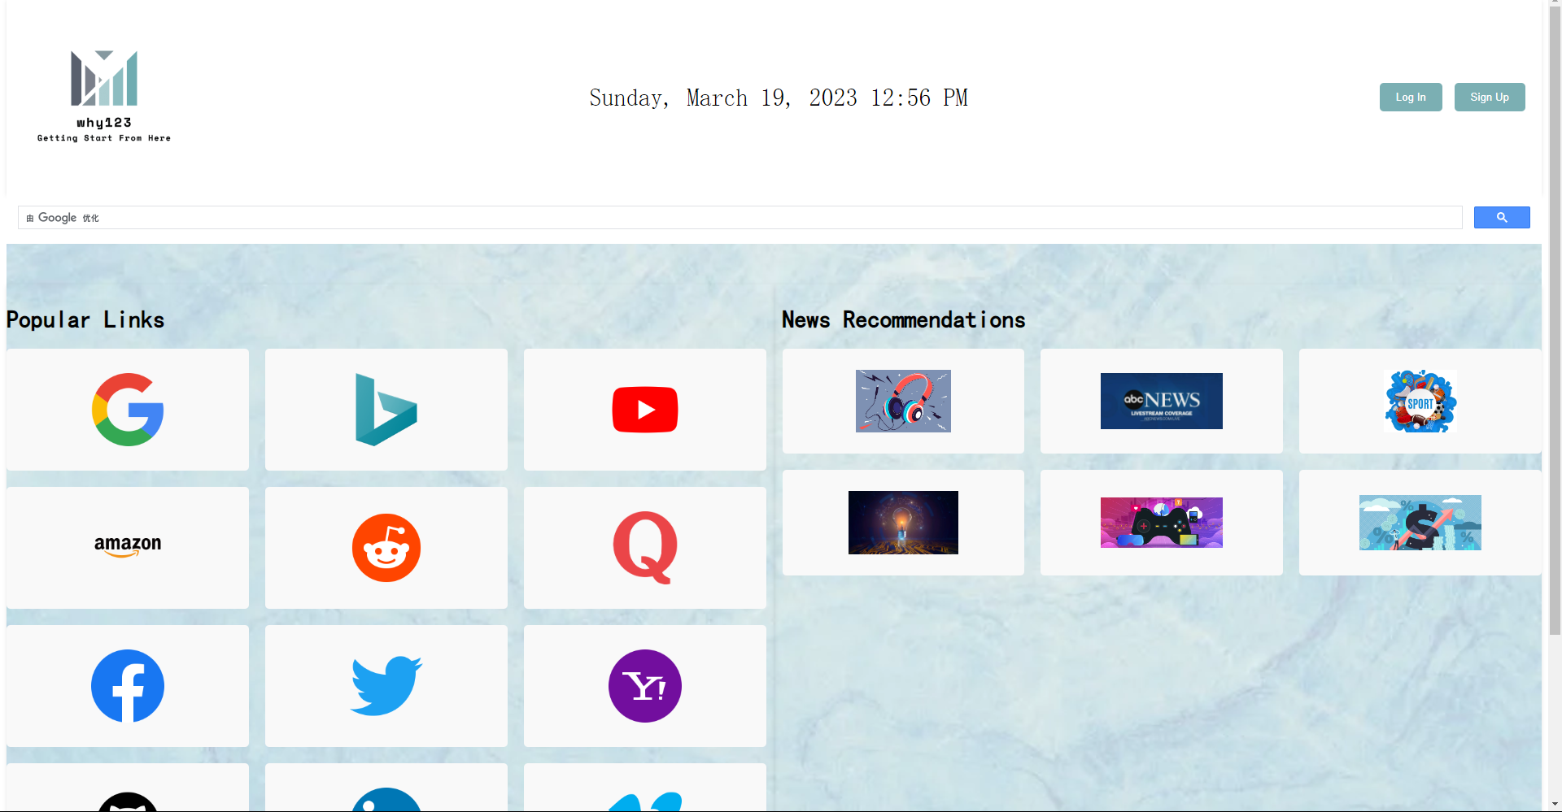
For not logged in or unregistered user
main page:
For users that are not logged in or unregistered, the main page will provide multiple default common websites and news sites.
Users can use buttons at the top-right of the page to log in or sign-up.

Slide 2
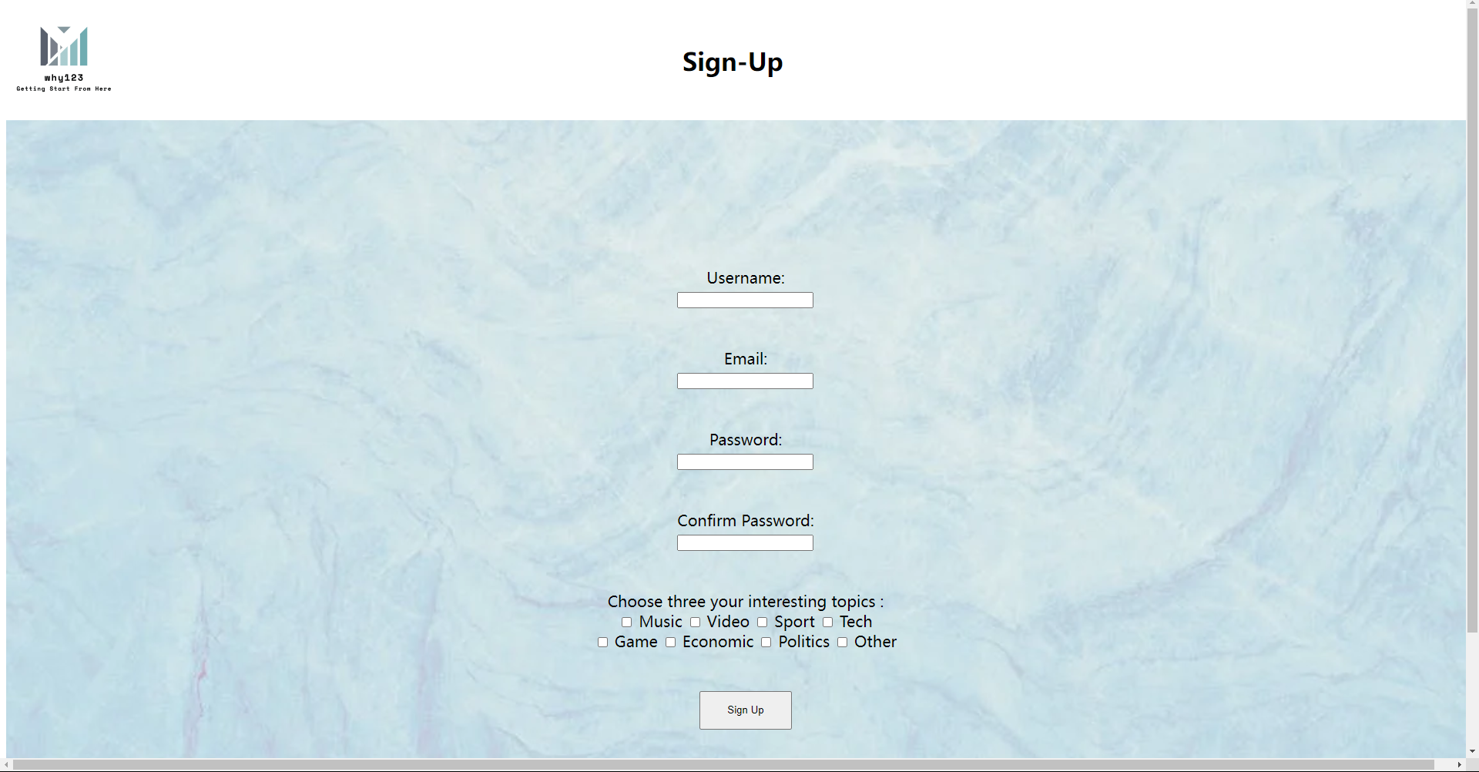
sign-up page:
For sign-up, users need to provide information like email, username, password, etc, and click submit button.

Slide 3
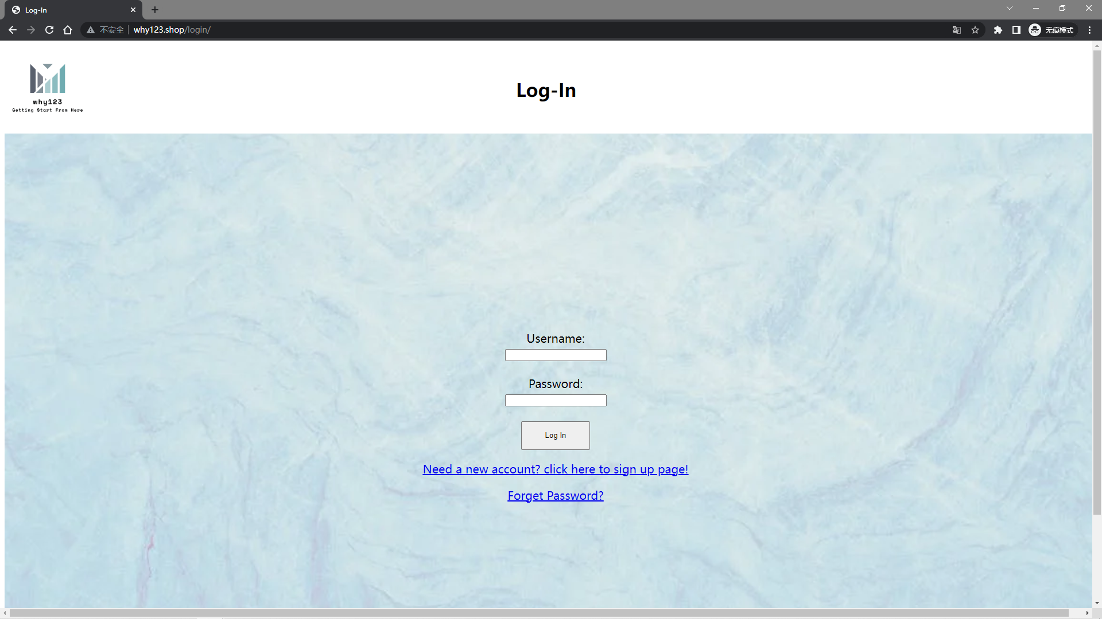
log in page:
For log-in, users are asked to type their username and password and then click submit button.

Slide 4
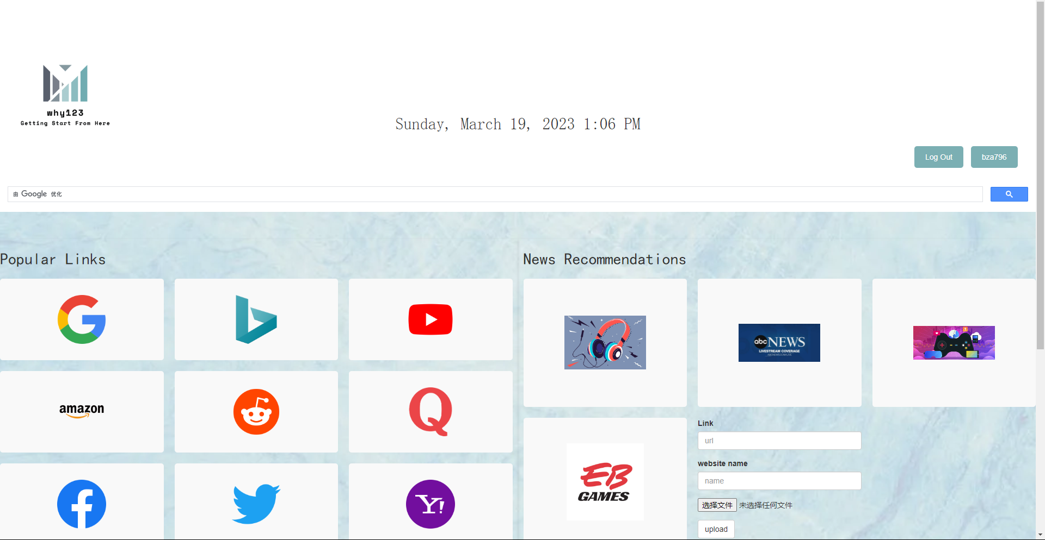
For login users
main page:
For log-in users, the top-right buttons will become log-out and the username. And log-in users can add a new website to the main page by typing in the URL, and the website name and uploading a website image if the user wants, the added website will be saved in the cloud.

